Slide 1
Data Pre-processing
Alex Belianinov
Machine Learning for Materials Research,
NIST, 2018

Slide 2
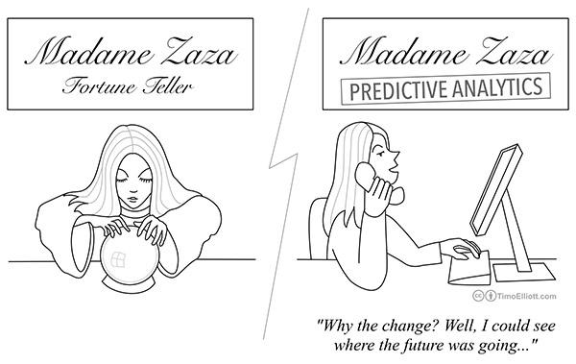

Slide 3
Isn’t my data already perfect?
Real world data are generally:
Incomplete: missing values, lacking attributes of interest, or containing only aggregate data
Noisy: containing errors or outliers
Inconsistent: containing discrepancies in codes or names
Tasks in data preprocessing:
Data cleaning: fill in missing values, smooth noisy data, identify or remove outliers, and resolve inconsistencies
Data integration: using multiple databases, data cubes, or files
Data transformation: normalization and aggregation
Data reduction: reducing the volume but producing the same or similar analytical results
Data discretization: part of data reduction, replacing numerical attributes with nominal ones.

Slide 4
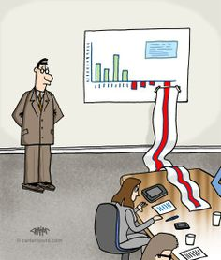
Outline
Data Cleaning
Background Subtraction
Noise
Interpolation/Smoothing
Inconsistencies – the importance of domain knowledge
Data Transformation
Normalization/Whitening
Feature Detection
Attribute creation: Feature Extraction

Slide 5
Data cleaning – Background Subtraction
A robust background subtraction algorithm should be able to handle changes, repetition, and long-term changes.
Thresholding and Frame Differencing (easy)
Thresholding is the simplest method of image segmentation that can be used to create binary images
Mean/Median Filters (easy)
Create a filter based on averaging of preceding frames, or local neighbors
Running Gaussian average (medium)
A filter used to classify pixels based on intensity confidence interval of its distribution's mean
Background Mixture models (hard)
An approaches that models each pixel as a mixture of Gaussians and uses an on-line approximation to update the model

Slide 6
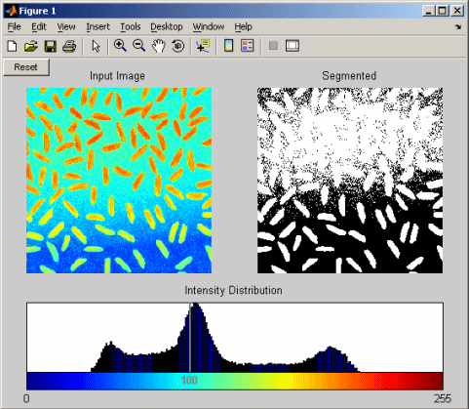
Thresholding for Background Extraction
In an a given image, if the image intensity I is less than some fixed constant T , this pixel is replaced with a black pixel (0), or a white pixel (1)

Slide 7
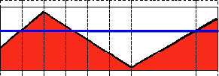
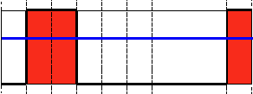
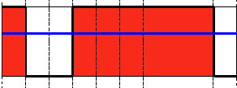
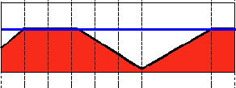
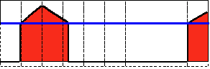
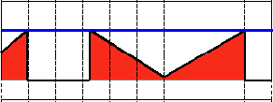
Global Thresholding for Background Extraction
Threshold Binary
Threshold Binary, Inverted
Truncate
Threshold to Zero
Threshold to Zero, Inverted

Slide 8
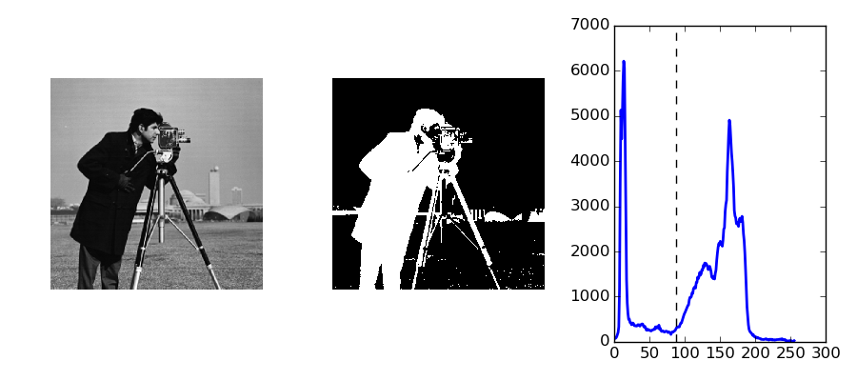
Thresholding - Otsu's method
Otsu's method, is used to automatically perform clustering-based image thresholding.
The algorithm assumes that the image contains two classes of pixels following bi-modal histogram (foreground pixels and background pixels), it then calculates the optimum threshold separating the two classes so that their combined spread (intra-class variance) is minimal.
1. Compute histogram and probabilities of each intensity level
2. Set up initial class probabilities and class means
3. Step through all possible thresholds
a. Update class probabilities and class means
b. Compute variance
4. Desired threshold corresponds to the maximum variance

Slide 9
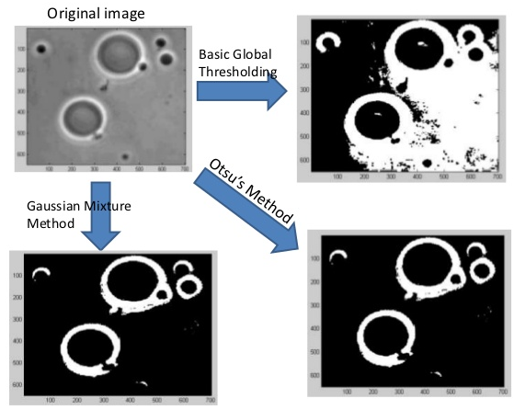
Thresholding and Frame Differencing - Example
Thresholding and frame differencing methods are excellent in reducing your data set to only the features of interest. This can help to greatly improve performance.

Slide 10
Thresholding Jupyter Example

Slide 11
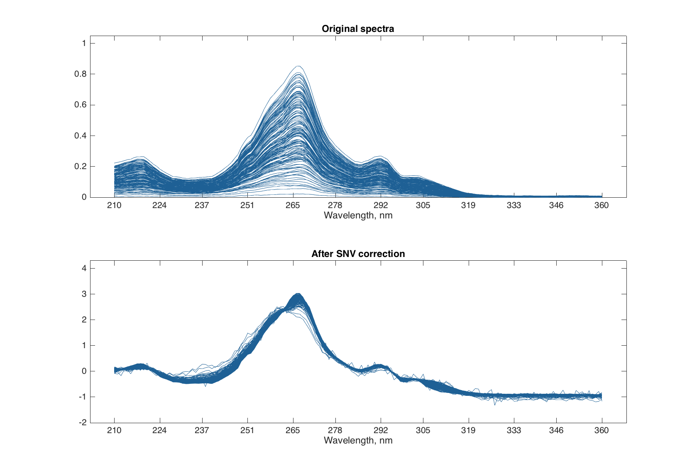
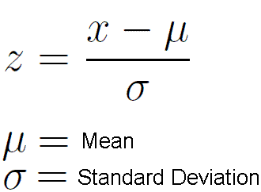
A word on Spectral Thresholding…
Basic Thresholding on spectral data isn’t very exciting (or informative)
However, baseline correction methods are absolutely vital for these types of signals. Standard Normal Variate, Multiplicative Scatter Correction and baseline correction with Alternating Least Squares are very useful.
SNV is a simple procedure aiming to remove additive and multiplicative scatter effects from spectra. Every data point of the spectra is subtracted from the global mean and divided by the global standard deviation.

Slide 12
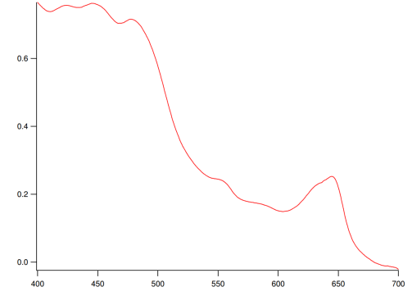
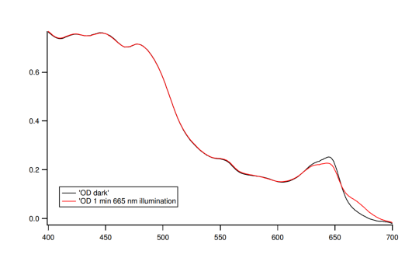
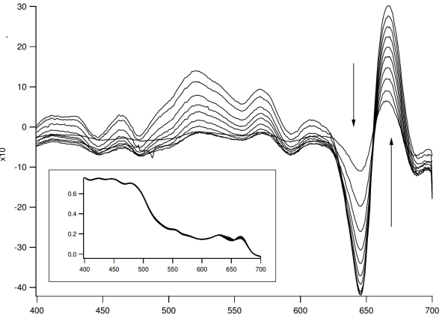
Thresholding ++ – Frame Differencing
Frame differencing is a technique where the difference in pixels between two video frames is obtained. If the pixels have changed there was something changing in the image (moving for example).

Slide 13
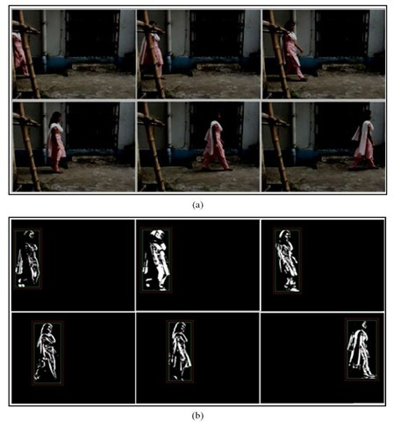
Thresholding ++ – Frame Differencing
Frame differencing is a technique where the difference in pixels between two video frames is obtained. If the pixels have changed there was something changing in the image (moving for example).
|Frame_{i} – Frame_{i-1}| > Th

Slide 14
Spectral processing Jupyter Example

Slide 15
Mean Filters
The mean filter is a simple sliding-window spatial filter that replaces the center value in the window with the average (mean) of all the pixel values in the window. The window, or kernel, is usually square but can be any shape.
Mean
Median
5 | 3 | 6
2 | 1 | 9
8 | 4 | 7
6 | 2 | 0
3 | 97 | 4
19 | 3 | 10
5 + 3 + 6 + 2 + 1 + 9 + 8 + 4 + 7 = 45 45 / 9 = 5
Mean filter would return 16:
Median filter removes “impulse
noise” – good for edge preservation
* | * | *
* | 5 | *
* | * | *
* | * | *
* | 4 | *
* | * | *

Slide 16
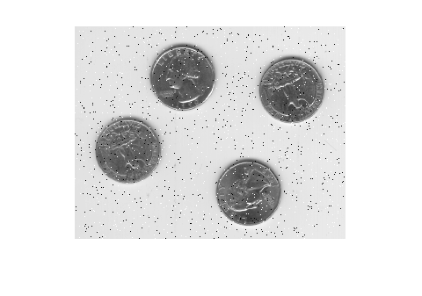
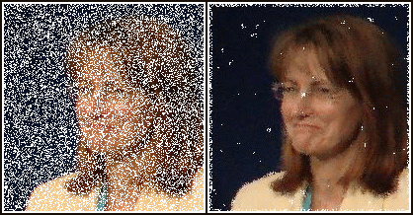
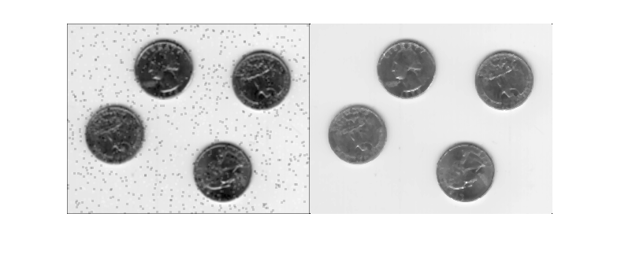
Mean/Median Filters
Original
Original
Median Filter
Mean Filter
Median Filter

Slide 17
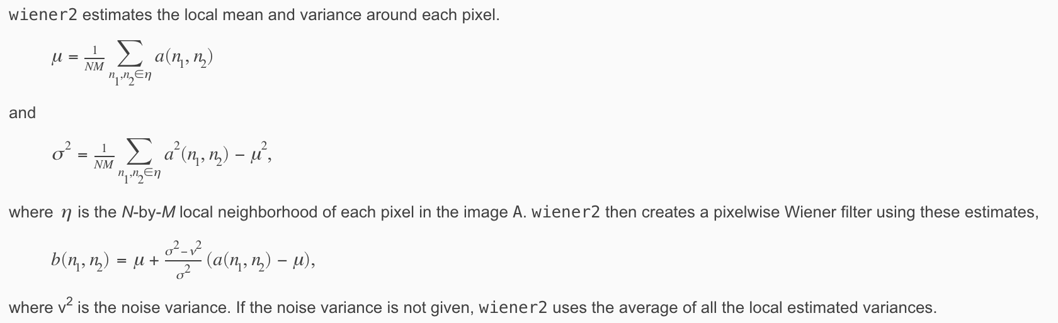
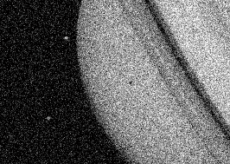

Adaptive Filters
Adaptive filters use a pixelwise adaptive methods based on statistics estimated from a local neighborhood of each pixel.
Before
After

Slide 18
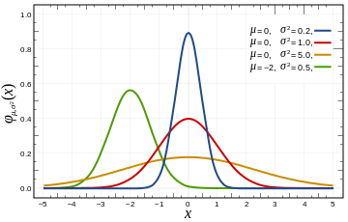
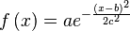
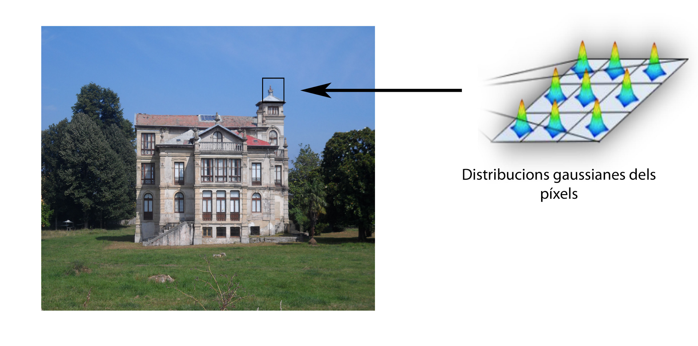
Running Gaussian Filters
This method computes the mean and variance in each pixel as a function of multiple frames.
This allows us to classify a pixel as background if its current intensity lies within some confidence interval of its distribution's mean:

Slide 19
Filtering Jupyter Example

Slide 20
Data cleaning – Interpolation/Smoothing
In numerical analysis, interpolation is a method of constructing new data points within the range of a discrete set of known data points.
Linear Interpolation
Linear interpolation is a method of curve fitting using linear polynomials to construct new data points within the range of a discrete set of known data points. In linear interpolation the error is proportional to the square of the distance between the data points.
Polynomial Interpolation
Polynomial interpolation is the interpolation of a given data set by a polynomial: given some points, find a polynomial which goes exactly through these points. Polynomial interpolation can estimate local maxima and minima that are outside the range of the samples, unlike linear interpolation.
Spline Interpolation
Spline interpolation uses low-degree polynomials in each of the intervals, and chooses the polynomial pieces such that they fit smoothly together. The resulting function is called a spline.

Slide 21
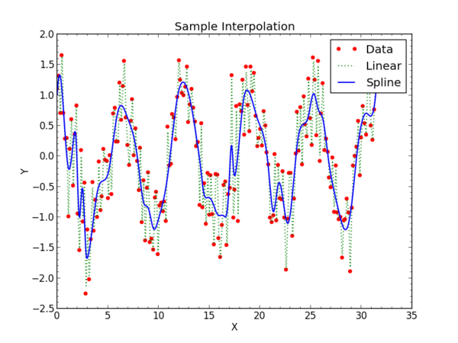
Data cleaning – Interpolation/Smoothing
In interpolation a Least Squares method is used to figure out the weights of each of the factors
The following examples show idealized data, some of the more challenging examples will be shown by Dan

Slide 22
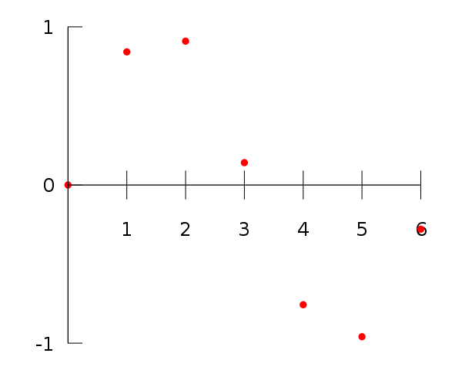
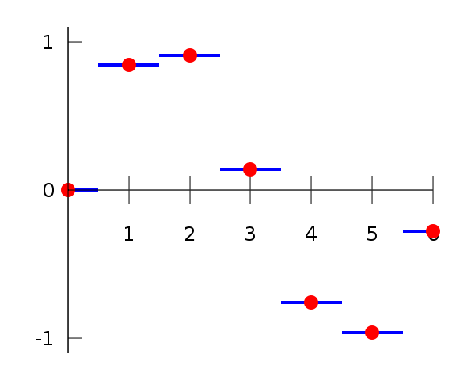
Data cleaning – Interpolation/Smoothing
Data points
Piecewise constant interpolation

Slide 23
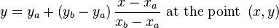
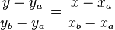
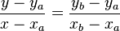
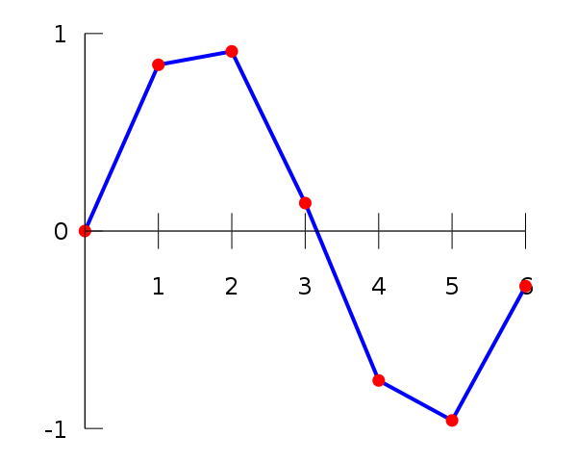
Data cleaning – Interpolation/Smoothing – Linear Interpolation
Linear interpolation takes two data points, (x_{a},y_{a}) and (x_{b},y_{b}), with the interpolant:
Linear interpolation is quick and easy, but it is not very precise. The main disadvantage is that the interpolant is not differentiable at the point x_{k}.

Slide 24
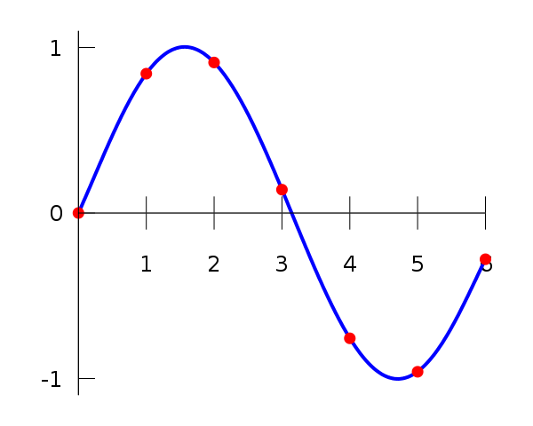
Data cleaning – Interpolation/Smoothing - Polynomial Interpolation
Polynomial interpolation is a generalization of linear interpolation. We now replace this interpolant with a polynomial of higher degree.

Slide 25
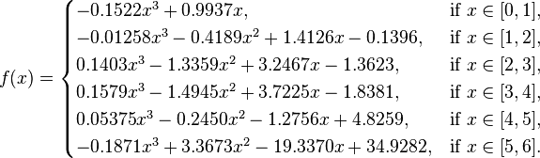
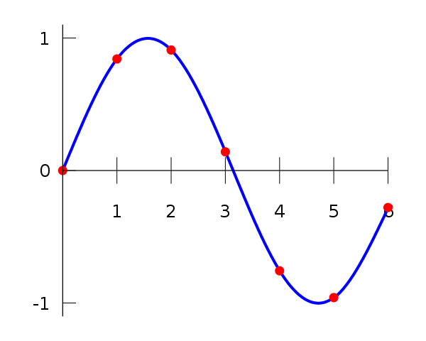
Data cleaning – Interpolation/Smoothing – Splines
Spline interpolation uses low-degree polynomials in each of the intervals, and chooses the polynomial pieces such that they fit smoothly together.
Like polynomial interpolation, spline interpolation incurs a smaller error than linear interpolation, and the interpolant is easier to evaluate than the high-degree polynomials used in polynomial interpolation.

Slide 26
Interpolation and Smoothing Jupyter Example

Slide 27
Inconsistencies – the importance of domain knowledge
True Zeros
A value that reads 1e⁻⁹, 1e⁻¹², or another small value that’s due to a double/float conversion is not a true zero.
Negative Values/Imaginary Numbers
Always check your data types. This can mean a difference between an algorithm that works and a nonsensical answer.
Check your range
What is the precision of the values you’re measuring? Are these captured by your recording methods? Is there an up/down conversion? What is the range between the smallest and largest values?

Slide 28


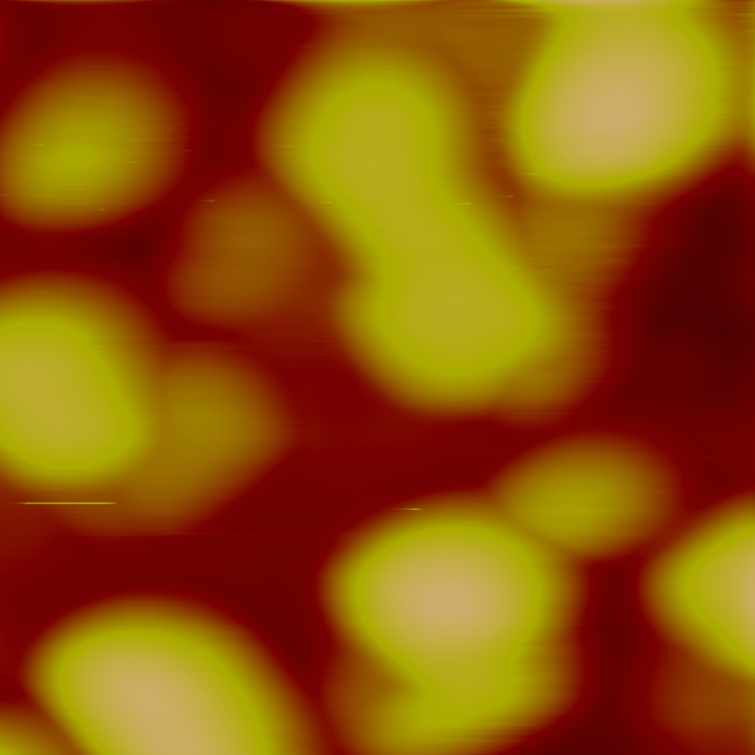
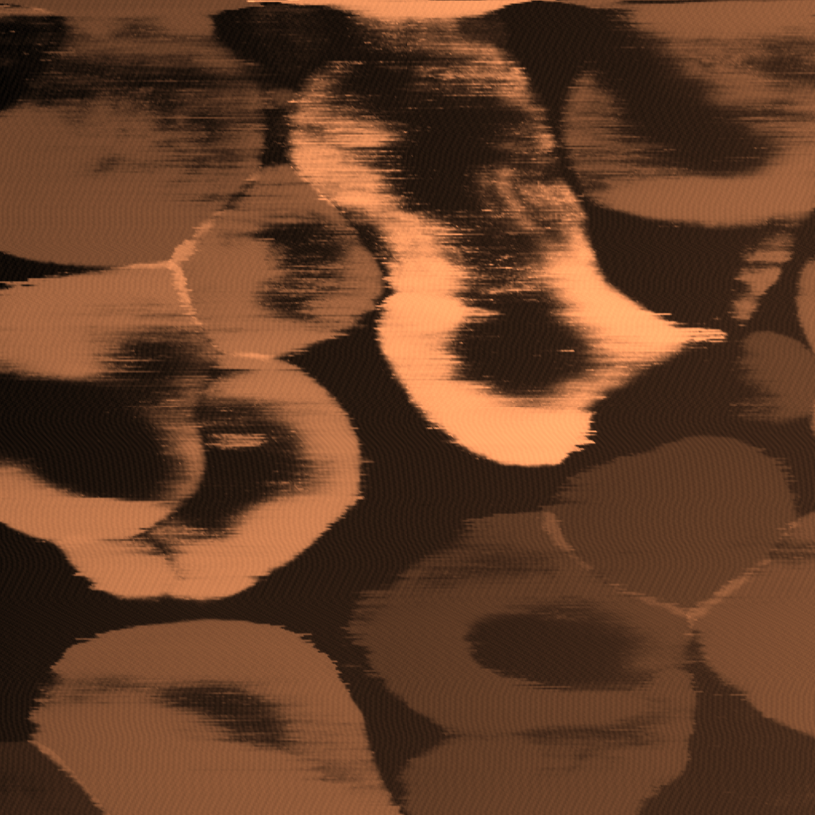
Inconsistencies – the importance of domain knowledge
BiFeO₃-CoFe₂O₄ FORC-IV
nm
pA
AFM tip
50
90
Ambient
BFO
25
45
CFO
R₂
R₁
0
0
Bottom electrode
A
nm
pA
44
188
1.5
5
Voltage (V)
1
0
UHV
0
1
2
3
94
time (s)
22
Current (nA)
0.5
0
0
0
2
4
Voltage (V)
E. Strelcov et. al. ACS Nano 8 (6) 6449-6457 (2014)
E. Strelcov et. al. Nano Letters 15 (4), 2343-2349 (2015)

Slide 29
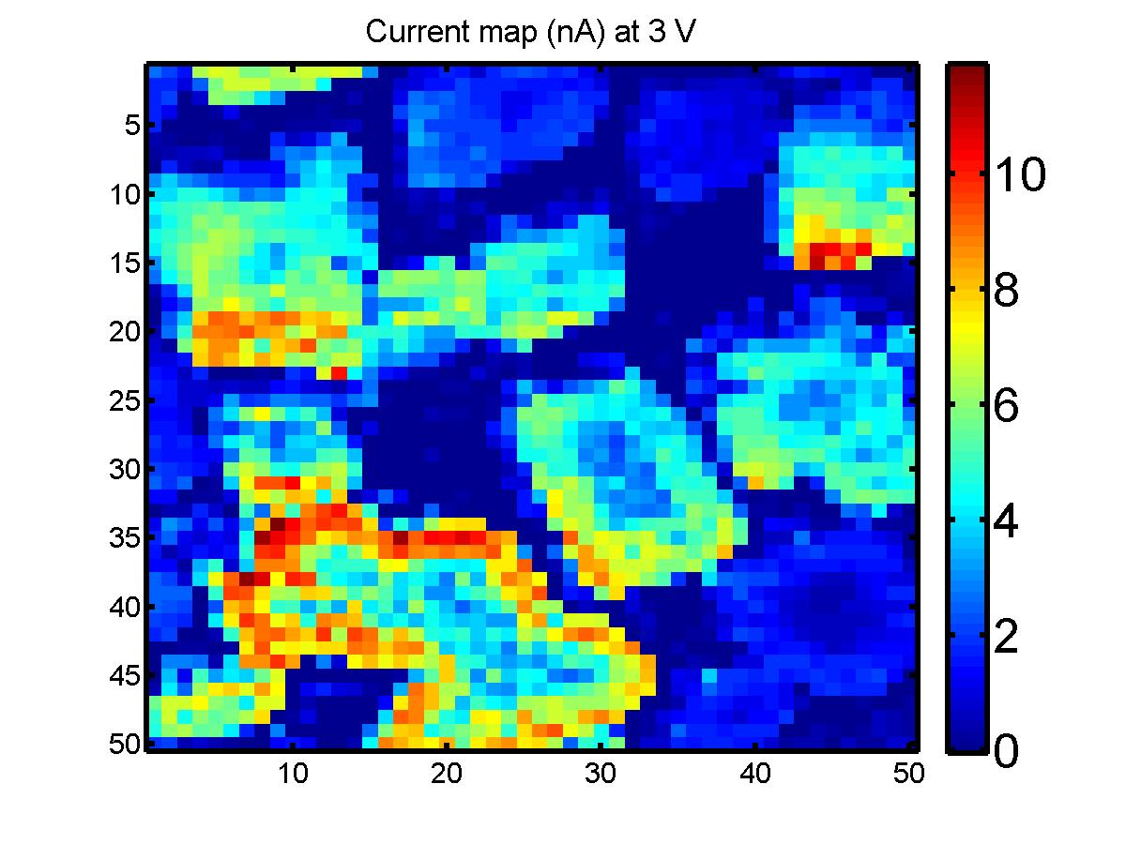
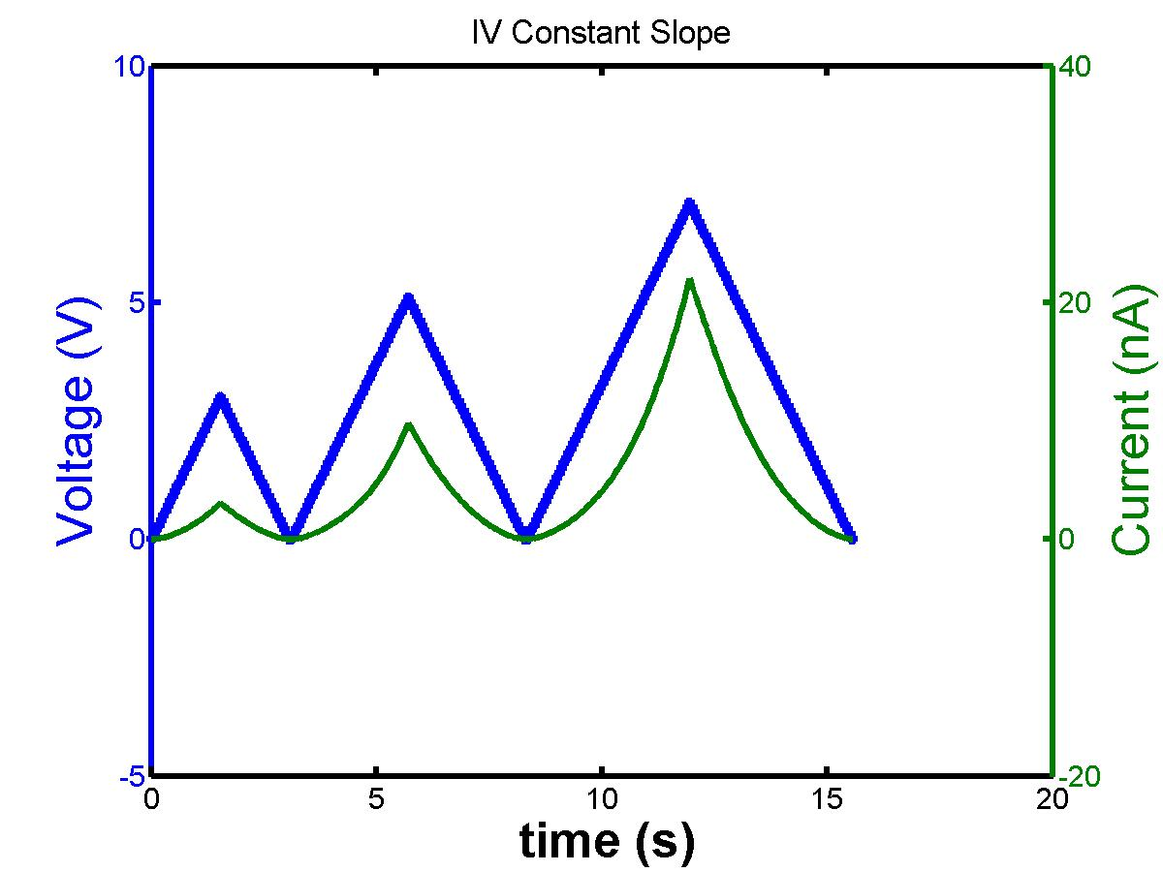
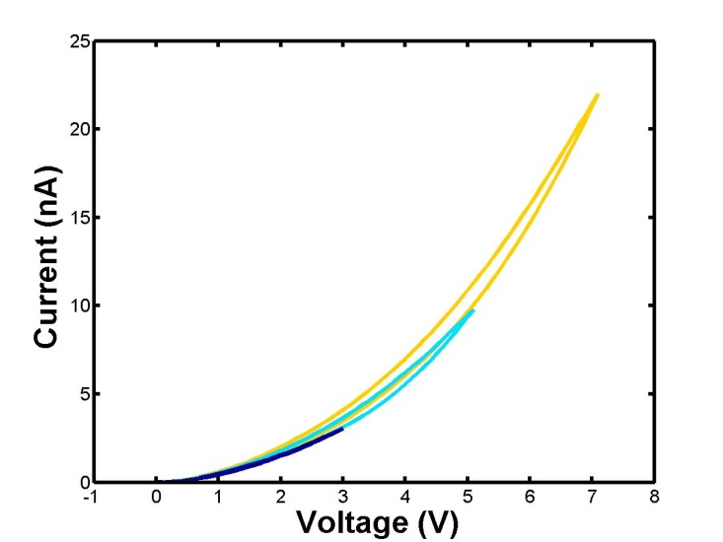
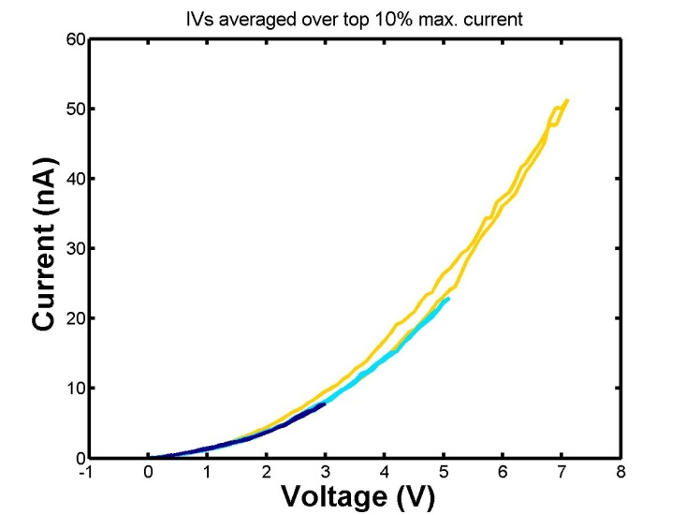
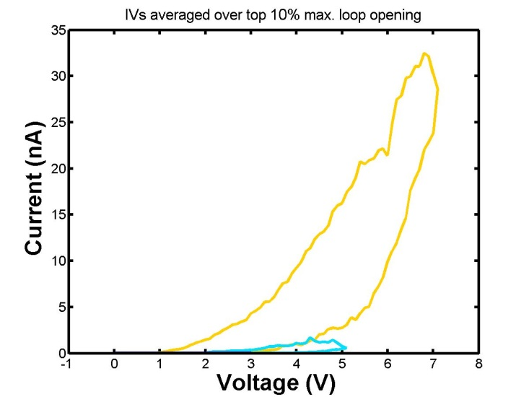
FORC-IV Measurement
3
2
1
3
2
1

Slide 30
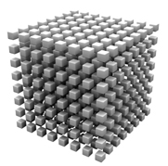
3D Data Architecture of a FORC-IV Measurement
I
V
The IV response is measured at each spatial pixel as a function of a triangular excitation wave peaking at an arbitrary pre-set maximal value
Multiple range IV curves are collected as a result – forming a 3D hyperspectral dataset; where the IV behavior vector is supported on a 2D grid
y
I-V
x

Slide 31
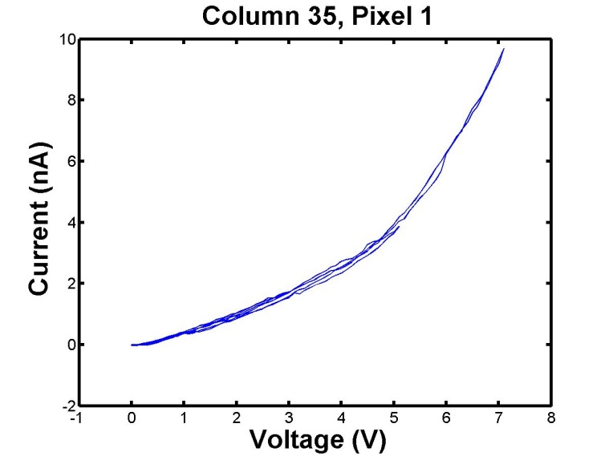
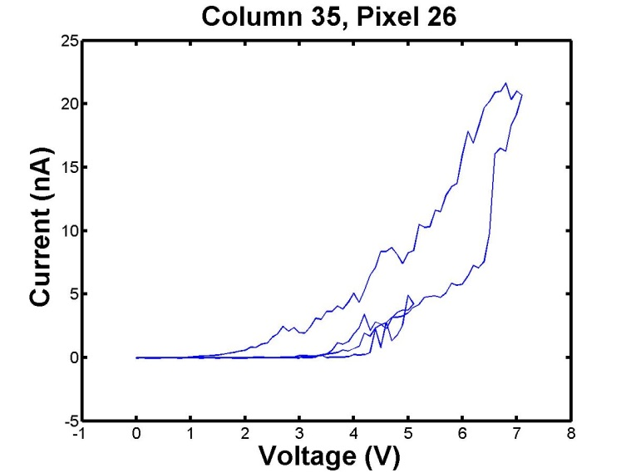
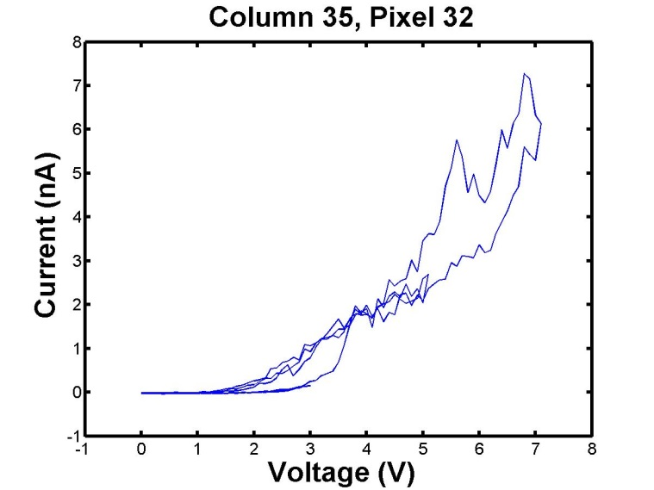
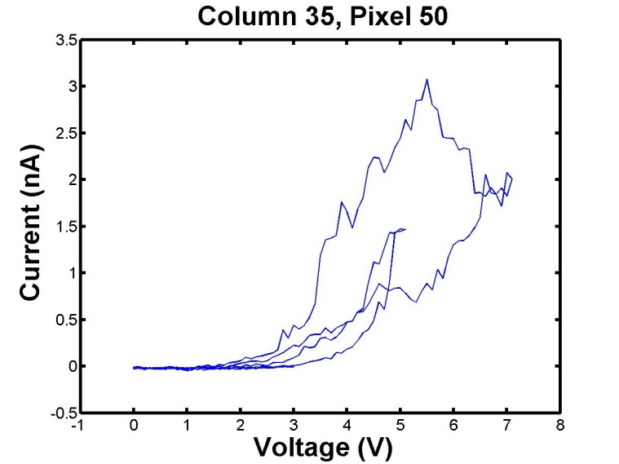
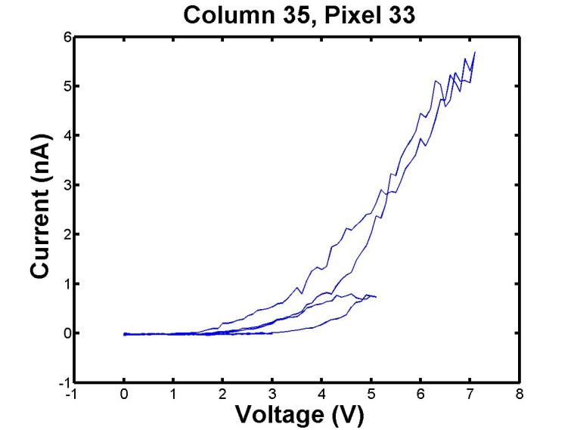
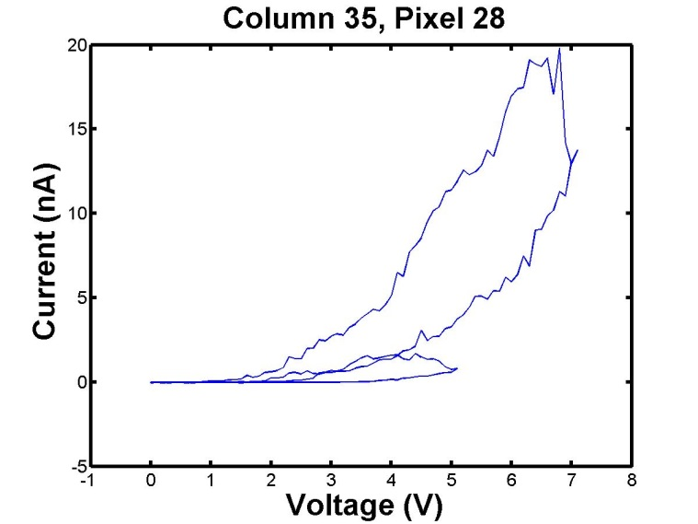
3D Data Architecture of a FORC-IV Measurement

Slide 32
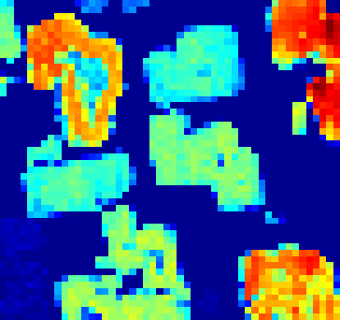






Bayesian Example: BiFeO3-CoFe2O4 FORC-IV, Vmax = 3V
2
2
0.02
1
1
1.5
30
1.5
15
0.8
1
2
3
0.6
4
Current (nA)
20
10
1
1
0.01
0.5
0.4
0.5
10
0.5
5
0.2
0
-1
0
1
2
3
0
0
-1
0
1
2
3
0
0
-1
0
1
2
3
0
0
-1
0
1
2
3
Voltage (V)
Voltage (V)
Voltage (V)
Voltage (V)
Ambient
0.8
1.0
0.8
0.5
0.8
0.6
0.4
0.6
0.6
0.4
0.3
0.4
0.4
0.2
0.2
0.1
0.2
0.2
0.0
0.0
0.0
0.0
UHV
0.8
0.8
0.8
0.8
0.6
0.6
0.6
0.6
Component
Absent
0.4
0.4
0.4
0.4
0.2
0.2
0.2
0.2

Slide 33
Inconsistencies
What am I sensing the signal with? What is the dynamic range of this tool?
What is the smallest/largest value? How quickly can it sample the signal
Is 10⁻²⁵ = 0?
What is the natively captured type and precision of the signal? Am I up- or down-sampling?
Run of the mill analytical chemistry detectors are 8 bit
Higher end detectors are 14-16 bit
High precision ($$$) 22 bit
Basic OS, 32 bit; is it upconverting the data? Remember your Sig Figs!
Single, double, unsigned, string … Oh My!
Artificial data poisoning – negative/imaginary values
Bits can flip, and you may induce these with prior preprocessing
Imaginary values can be your best friend, or your worst enemy – you decide

Slide 34
Hyperspectral Jupyter Example

Slide 35
Data Cleaning Conclusions
No measurement is perfect, every device, detector, data collector has a limitation and a spec
Consider data flows, analog to digital conversion, and precision
Know how outliers are treated and represented
Use interpolation to your advantage, matching the number of data points between measurements unlocks multivariate algorithms capabilities
Do not overfit your data, use the scientific insight
Know the capabilities and limitations of the filters you are using
Play! Try out things to see if they work
People with insight of how the data was collected, amassed, and pre-processes almost always area at advantage

